Slide 1
Project work – Proposal Defence On Hostel Management System
Presented by:
Sagar Adhikari (6-2-40-50-2020)
July 2024

Slide 2
Project Outline
About project
Methodology
Scheduling
Conclusion
references

Slide 3
Introduction
Offers centralized platform where users can explore, compare and look hostels among multiple options available.
Key features include multi-hostel search and comparison, booking, user reviews and ratings.
Users can search for hostels based on various criteria, comparing options side by side.
The proposed system gives nearest hostel based on the user location.

Slide 4
Problem Statement
Poor room allocation leads to suboptimal room assignments, resulting dissatisfaction among users and underutilization of space.
Current hostel management system lacks an efficient room booking feature, leading to frequent issues with overbooking.
Lack of an user friendly system to easily compare prices among different hostels, leading to inconvenience.

Slide 5
Objectives
To implement a system that allows users to book rooms.
To develop a system with good user interface in comparing prices among different hostels.

Slide 6
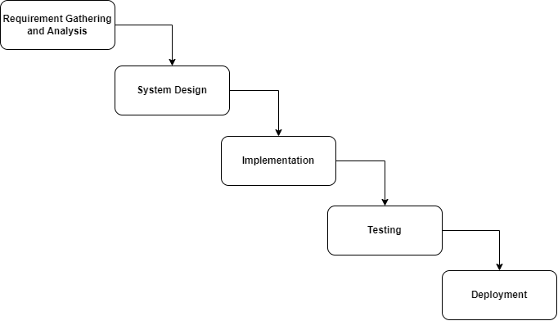
Development Methodology
The proposed system is developed with waterfall methodology, as the requirements are pre-known. The next stage in waterfall methodology is gone only after completion of current stage.
Figure 1: Waterfall Model

Slide 7
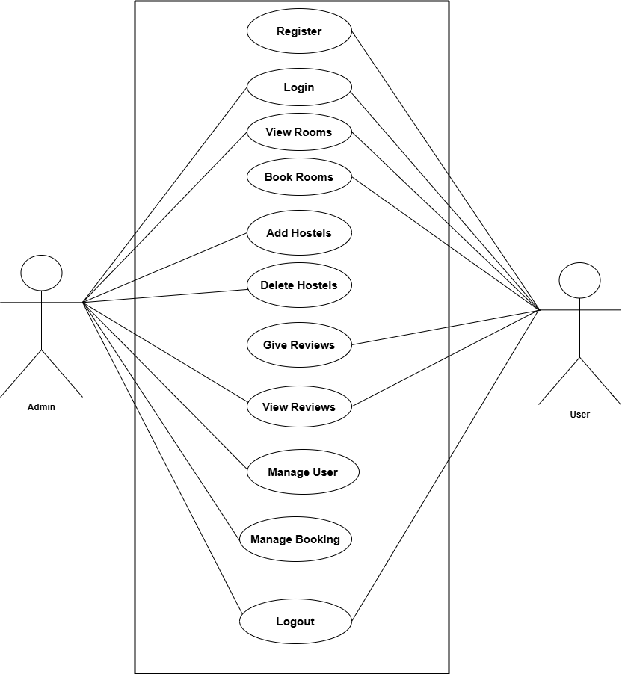
Requirement Analysis (Use-Case Diagram)
Figure 2: Use Case Diagram of Hostel Management System

Slide 8
Figure 2 shows the Use Case diagram of the proposed system. The functional requirements
of the admin and users are as follows:
For Admin
Admin can login to the system.
Admin can add, delete the hostels.
Admin can manage users and bookings.
Admin can view the reviews given by the user.
Admin can logout from the system.
For User
User can register, login to the system.
User can view the rooms
User can book the rooms.
User can Give reviews and can view other reviews as well.
User can logout of the system.

Slide 9
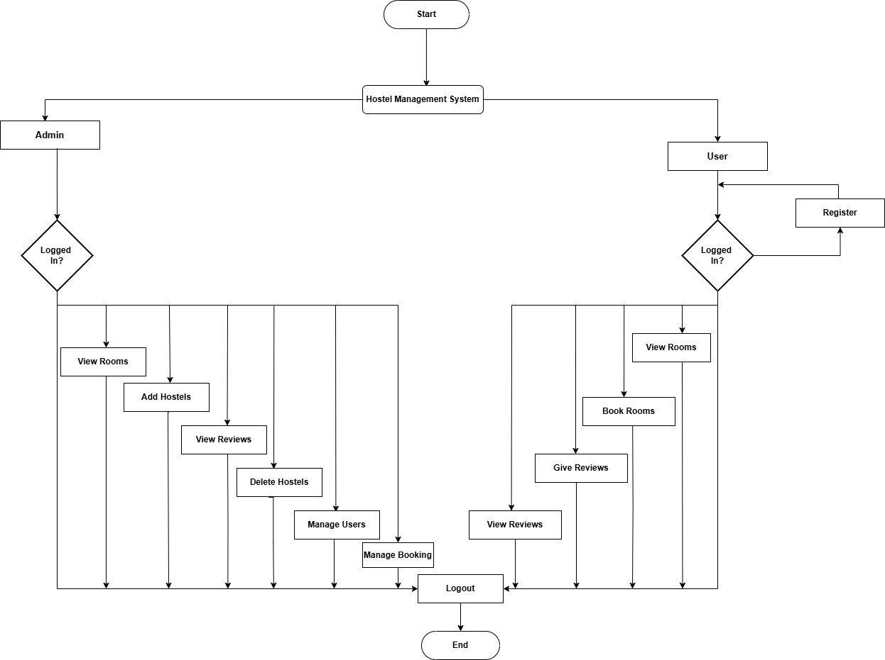
Flowchart
Figure 3: Flowchart of Hostel Management System

Slide 10
Figure 3 shows the system flowchart of the proposed system. The flowchart effectively splits the functions of the hostel
management system into two main user categories: Admin and User.
Admin Functions:
Logged In? - Ensures only authenticated access.
View Rooms - Manages room .
Add Hostels - Updates database with new hostels.
View Reviews - Monitors user feedback.
Delete Hostels - Removes outdated hostels.
Manage Users - Controls user accounts.
Manage Booking - Oversees bookings.
Logout - Ends session securely.
User Functions:
Register - Creates new accounts.
Logged In? - Ensures authenticated access.
View Rooms - Browses available rooms.
Book Rooms - Books accommodations.
Give Reviews - Provides feedback.
View Reviews - Reads guest feedback.
Logout - Ends session securely.

Slide 11
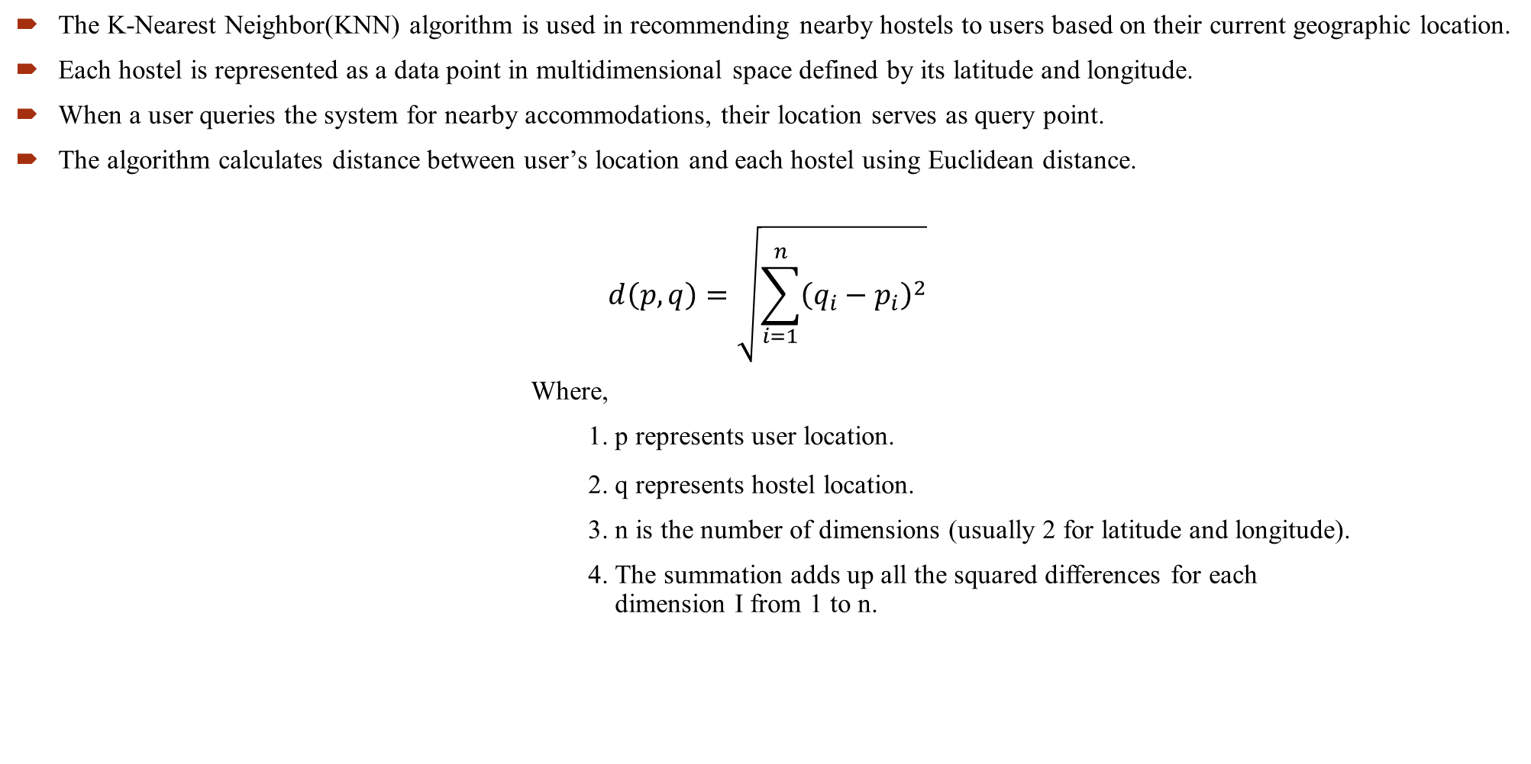
Description of Algorithm
The K-Nearest Neighbor(KNN) algorithm is used in recommending nearby hostels to users based on their current geographic location.
Each hostel is represented as a data point in multidimensional space defined by its latitude and longitude.
When a user queries the system for nearby accommodations, their location serves as query point.
The algorithm calculates distance between user’s location and each hostel using Euclidean distance.
$$d\left(p,q\right)=\sqrt{\sum_{i=1}^{n}{{\left(q_{i}−p_{i}\right)}^{2}}}$$
Where,
1. p represents user location.
2. q represents hostel location.
3. n is the number of dimensions (usually 2 for latitude and longitude).
4. The summation adds up all the squared differences for each dimension I from 1 to n.

Slide 12
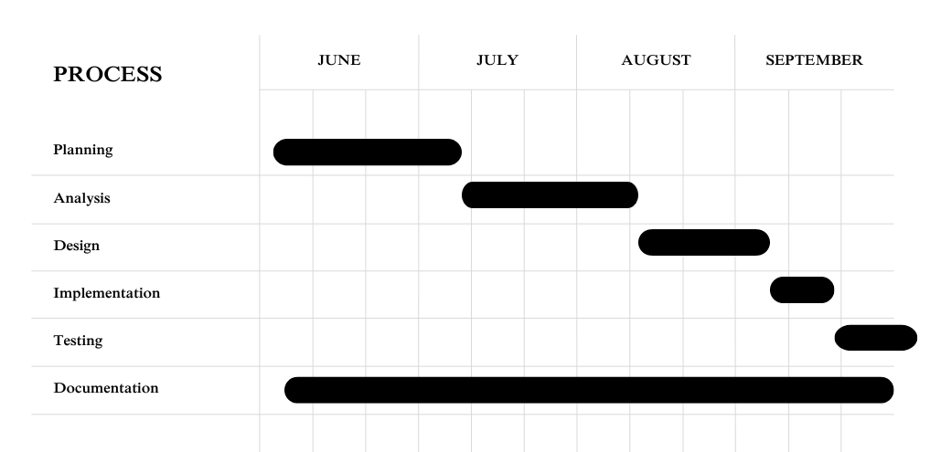
Gantt Chart
Figure 4: Gantt Chart

Slide 13
Expected Outcome
The proposed system provides an easy UI to interact with and also helps to compare the price of hostels across different places.
The proposed system aims to provide easy and simple interface to book hostel according to requirements.

Slide 14
References
[1] | "Hostelz," [Online]. Available: https://www.hostelz.com/. [Accessed 06 July 2024].
[2] | "Agoda," [Online]. Available: https://www.agoda.com/. [Accessed 6 July 2024].
[3] | "HostelWorld," [Online]. Available: https://www.hostelworld.com/. [Accessed 06 July 2024].
[4] | "Hostelling International," [Online]. Available: https://hihostels.com/. [Accessed 8 July 2024].
[5] | K. K. M. R. P. Reddy, "Effectiveness of Hostel Management System in College Hostels," International Journal of Advanced Research in Computer Science and Software Engineering, pp. 104-109, 2019.
[6] | R. G. S. Gupta, "A Web-Based Hostel Management System," Journal of Software Engineering and Applications, pp. 159-165, 2016.

